Slide 1
Literature Review

Slide 2
Dealing with Data Quality Issues
Common techniques with data quality issues (e.g. missing tuples/values) include imputation and removal but how does this affect demographic fairness of the dataset?
Error detection and data repair
Main challenges/disparities
holistic data quality
effectiveness of data cleaning methods
ML model performance

Slide 3
Hypothesis
Automated data cleaning techniques
have significant impact on model accuracy
more likely to worsen fairness than to improve it
Two Main Concerns
Does poor data quality track disadvantaged groups?
Does the data cleaning process of these disadvantaged data points impact fairness of the resulting ML models?
Essentially, are we aware of the potential impact of any data that is cleaned (i.e. removed or imputed)?

Slide 4
Methodology
5 well-known datasets commonly used in research on responsible ML and data management
Built over 26,000 ML models to evaluate the effects on fairness and accuracy with no synthetic noise and just the raw data
Error detection strategies
Missing values: NULL and NaN values
Outliers identification with standard deviation, interquartile range, and isolation forest
Label errors: any tuples that are labeled as error with cleanlab library and logistic regression as base classifier
Cleanlab identifies error labels by estimating the joint distribution between given and unknown labels

Slide 5
Methodology Cont.
Automated repair methods
Missing values: numerical values are filled with column mean or mode, categorical values are filled with column mode or a constant “dummy” value
Outliers: replaced with column mean or mode
Label errors: Flipping the labels of flagged tuples

Slide 6
Research Question 1 (RQ1)
Does the incidence of data errors track demographic group membership in ML fairness datasets?

Slide 7
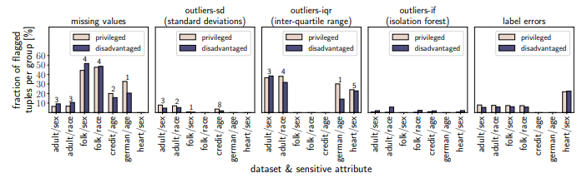
RQ1 Preparation
G - squared significance test with threshold of p=0.05
Graphs are distinguished by dataset, sensitive attribute, error type, and detection strategy
Y-axis represents the fraction of the tuples that are flagged as erroneous

Slide 8
RQ1 Results and Discussion
Mixed results in three types of errors
In heart dataset, privileged group has slightly higher FP rate (57.7% to 52.2%) and disadvantaged group has slightly higher FN rate (42% to 47.8%)
Potentially problematic since FN can exacerbate disadvantage and FP can amplify advantage
Not enough evidence to suggest poor quality data tracks disadvantaged groups

Slide 9
Research Question 2 (RQ2)
Do common automated data cleaning techniques impact the fairness of ML models trained on the cleaned datasets?

Slide 10
RQ2 setup
Goal: quantify the downstream impact automated data repairs on the fairness and accuracy ofML models.
Models:
Logistic Regression
K Nearest Neighbors
Xgboost decision Trees
Methodology:
Predictive Parity
Equal Opportunity

Slide 11
Detection Strategies
26,400 model evaluation
Different classifiers handle different errors with some exceptions
Missing values
Categorical errors - mislabeled values
Numerical errors - missing values / null values
Imputed values require consistency as either the mean

Slide 12
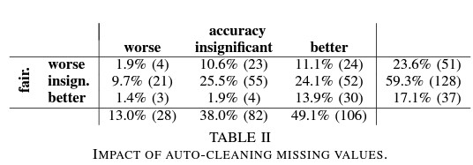
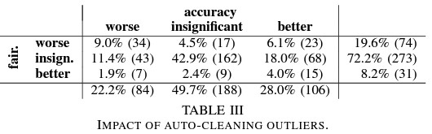
RQ2 Results and Discussion
Missing Values
Outliers
Accuracy: Better results than insignificant
Fairness: Although insignificant worsened
Higher % of insignificant results
Fairness worsened compared to slightly better accuracy

Slide 13
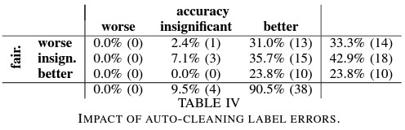
RQ2 Results and Discussion
Label Errors
Accuracy: highest among all cleaning
Fairness: Similar positive, negative, significant impact

Slide 14
Impact of Repair Techniques
Auto cleaning adapts to different models
Improve predictive parity than equal opportunity
Dummy imputation = improved fairness (22 vs 15)
Missing values : N/A new attribute folk dataset
Outliers Detection strategy:
SD : Improved fairness (16) ====== optimal flag
IF - CLAUSE: (11) ======= High FN/ less flagged records
IQR : 4 ==== Flags many records/ less significant results / high FP

Slide 15
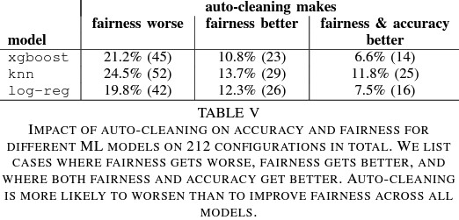
Model : Fairness / Accuracy
Avg model efficiency among rest
impact to likely worsen fairness than improve
XGBoost: Highest accuracy in general
Log-reg : Highest accuracy ifor clean labels
KNN - insignificant accuracy impact
XGBoost: Least benefit from cleaning
Log-reg : Smallest -ve impact
KNN -Biggest benefit from cleaning

Slide 16
Conclusion
Difficult holistic study requires further research
Fairness sensitive models : future
Insufficient evidence of demographic dependency/ negative impact on fairness /mitigate future impact
Research question:
Effective clean procedures? Additional empirical evaluation
New fairness-aware cleaning procedures? Cross validation?
Limitations:
Consider intersectionality of formulas
US-centric datasets

Slide 17
Discussion
Critiques
The general structure of the paper is a bit redundant because the conclusion is reiterated several times before the conclusion section.
In conjunction, the paper does not present all data before drawing a conclusion. For example, the authors conclude after presenting one table that automated cleaning technique shows a tendency for worsening fairness.
"59.3% of the times it has no significant impact on fairness. Worryingly however, when cleaning does have an impact on fairness, it is more likely to have an adverse impact (23.6%) than a positive one (17.1%)" page 5
The authors decided that the 9.3% difference would be considered "no significant impact" while 6.5% between positive and adverse impacts is considered a significant enough to draw this conclusion. There doesn't seem to be clear criteria for this decision.
The paper also suggests to retire some datasets for being outdated but ultimately does not have the statistical evidence to back the claim.

